Slide 1

Google Analytics Group Project
Team 5 : Luther Dai | Ruchi Kakkad | Michael Guel

Slide 2


Background
Programs to focus on:
Executive MBA (EMBA)
Masters in Accounting (MSA)
Keywords used to create the filtered page on Google Analytics:
1. np - broad.msu.edu/masters/accounting/
2. np - broad.msu.edu/masters/accounting/admissions/
3. np - broad.msu.edu/masters/accounting/curriculum/
4. np - broad.msu.edu/tag/msa/
5. np - broad.msu.edu/masters/executive-mba/
6. np - broad.msu.edu/masters/executive-mba/tuition/
7. np - broad.msu.edu/masters/executive-mba/curriculum/
8. np - broad.msu.edu/masters/executive-mba/student-experience/
9. emba msu
10. msu emba
11. np - broad.msu.edu/news/emba-graduation-honors-students-faculty/
12. michigan state emba
13. michigan emba
14. np - broad.msu.edu/masters/executive-mba/
Key words are all the relevant pages for the two programs on the broad site.
Notes:
The keyword custom filter allows the target data to be holistic as it would target both text search an url search. By including all the possible keywords for the allotted programs the target group is better narrowed down.

Slide 3





Visitor performance, site retention and site engagement
TRENDS : Site visitors rate have improved over-time while the session rate has decreased
Site Visitors
Bounce Rate
Session Rate
RECOMMENDATIONS
Use is engaging videos / images / testimonies
Improving the targeting of audience using ML
Site engagement options like FAQ, brochure download, etc
Optimize call of action placement
Notes:
While site traffic is high, the bounce rate is also high – resulting in users leaving the website without taking the target action(s). Hence the session rate is low
Hence the above recommendations can help the user towards the self-directing action on the website.
The landing page through adds can be customized per user – based on their historical search patterns

Slide 4



Sources of Traffic
TRENDS : All sources of traffic have performed in an increasing trend as compared to the previous year
Organic Searches
Paid Searches
Referral Searches
Highlight the social media pages in order to increase traffic from other sources
Send chain newsletters on email
RECOMMENDATIONS
The keyword research is on-point, sustain it
Write and print guest posts
Notes:
All three types – organic, paid and referral searches have gone up for both the courses. To sustain the same we must follow the best – practices as mentioned in the recommendations.
Traffic source analysis is the tracking and measuring of data from different acquisition sources like Google, social media, or referral links. This tracking can also help to mark on all the marketing that worked well

Slide 5


Goal Conversion Rate
TRENDS : Goal conversion has dropped overall. EMBA has higher goal conversion than the MSA program.
Executive MBA
M.S. Accounting
RECOMMENDATIONS
Add actionable pop-up to the website
Add third-party sign-up services
Add live chat to the website
Make landing to demand pages easy
Notes:
Goal conversion rate is not directly related to user traffic. Since goal conversion has gone down for both the courses over-time there is a need of smart goal conversion in this case.
Smart Goals are configured at the view level. Smart Goals use machine learning to examine dozens of signals about the website sessions to determine which of those are most likely to result in conversions.
Hence using historical data to conclude what has worked and what has not worked must be used to tweak the marketing strategy and the website

Slide 6
Differences between the segmented groups
TRENDS : More visitors only spent no more than 10 seconds on the page . Only EMBA program has ad campaign
1st
2nd
3rd
Language
US English
UK English
Chinese Taiwan
Location
US
India
Taiwan
Device
Desktop
Mobile
Tablet
Browser
Chrome
Safari
Edge
RECOMMENDATIONS
Add language options in the webpage for foreign language users
Ad campaign to for MSA
Collect data about user demographic
Do more ad campaign targeting India
Notes:
Based on location and language it is concluded to have focused digital marketing in the top 80% users (pareto rule) as well as the areas with least users. The content can be customized to these areas. Example : if the search history shows maximum search on EMBA in China – there can be offer adds in that region
The dimension view of mobile and tablets can be made more user friendly. Desktop is normally a choice dur to the ease of use, however mobile and tablets are more frequently used in day-to-day life. Hence one click application/one click request info options can be helpful.
Age and gender have no significant effect on varying trends. Hence background data collection on user age can be done to do tailored marketing to he age-group which is most likely to take these courses.

Slide 7




Summary
Business Context
Increase: Users, site traffic, organic search, ad campaign users, paid search
Decrease: Goal conversion rate, time spent on site.
Digital Marketing
Site Traffic
Goal Conversion
Net Profit
RECOMMENDATIONS
Live Chat Bot
Simplified info page
Visually self-directing registration page
Using user search history to customize site-options
Notes:
Business Standpoint:
- Marketing is attracting new users/site traffic I.e. this is working
- More users doesn't mean more goal conversions (proportional), it has a negative effect as we can see a decrease in goal conversions, increase in bounce rate and decrease in average session duration
- More users, though they are demonstrating the same tendencies
- Given that marketing is working, how do you now change those tendencies to better reach goals and improve metrics?
-Simplify request info page. User should only fill out their name and email on that page
-Add chat bot function on the page and count user interaction with the chat bot as goal conversation

Slide 8
Appendix

Slide 9
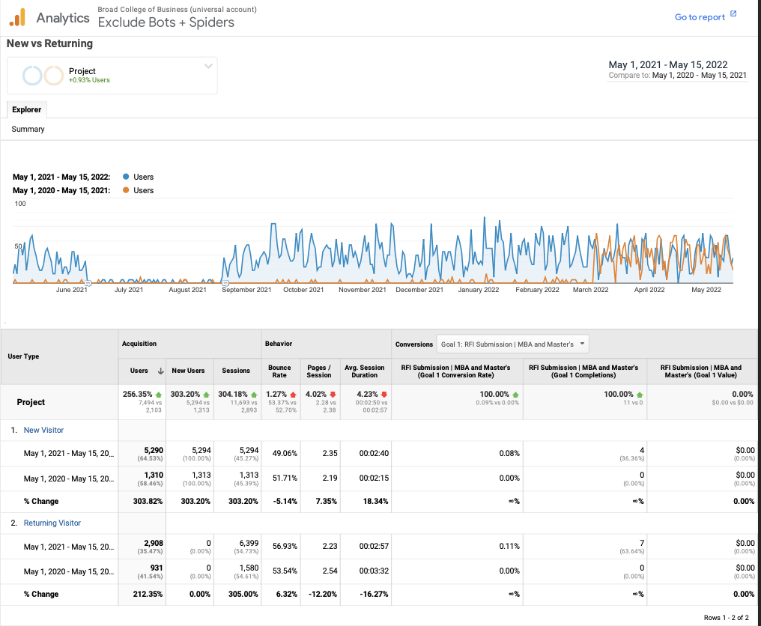
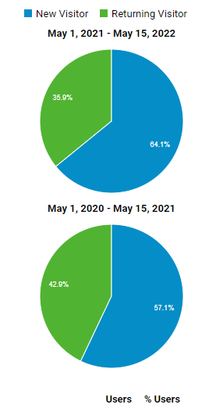
Visitor performance, site retention and site engagement

Slide 10
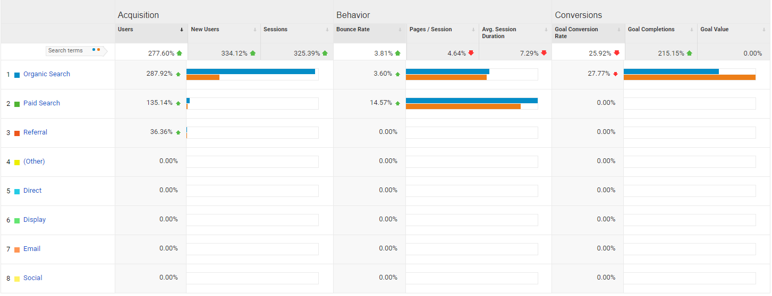
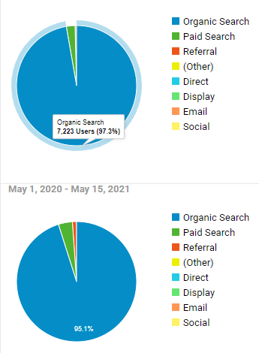
Sources of Traffic
Most of the site traffic came from organic search

Slide 11
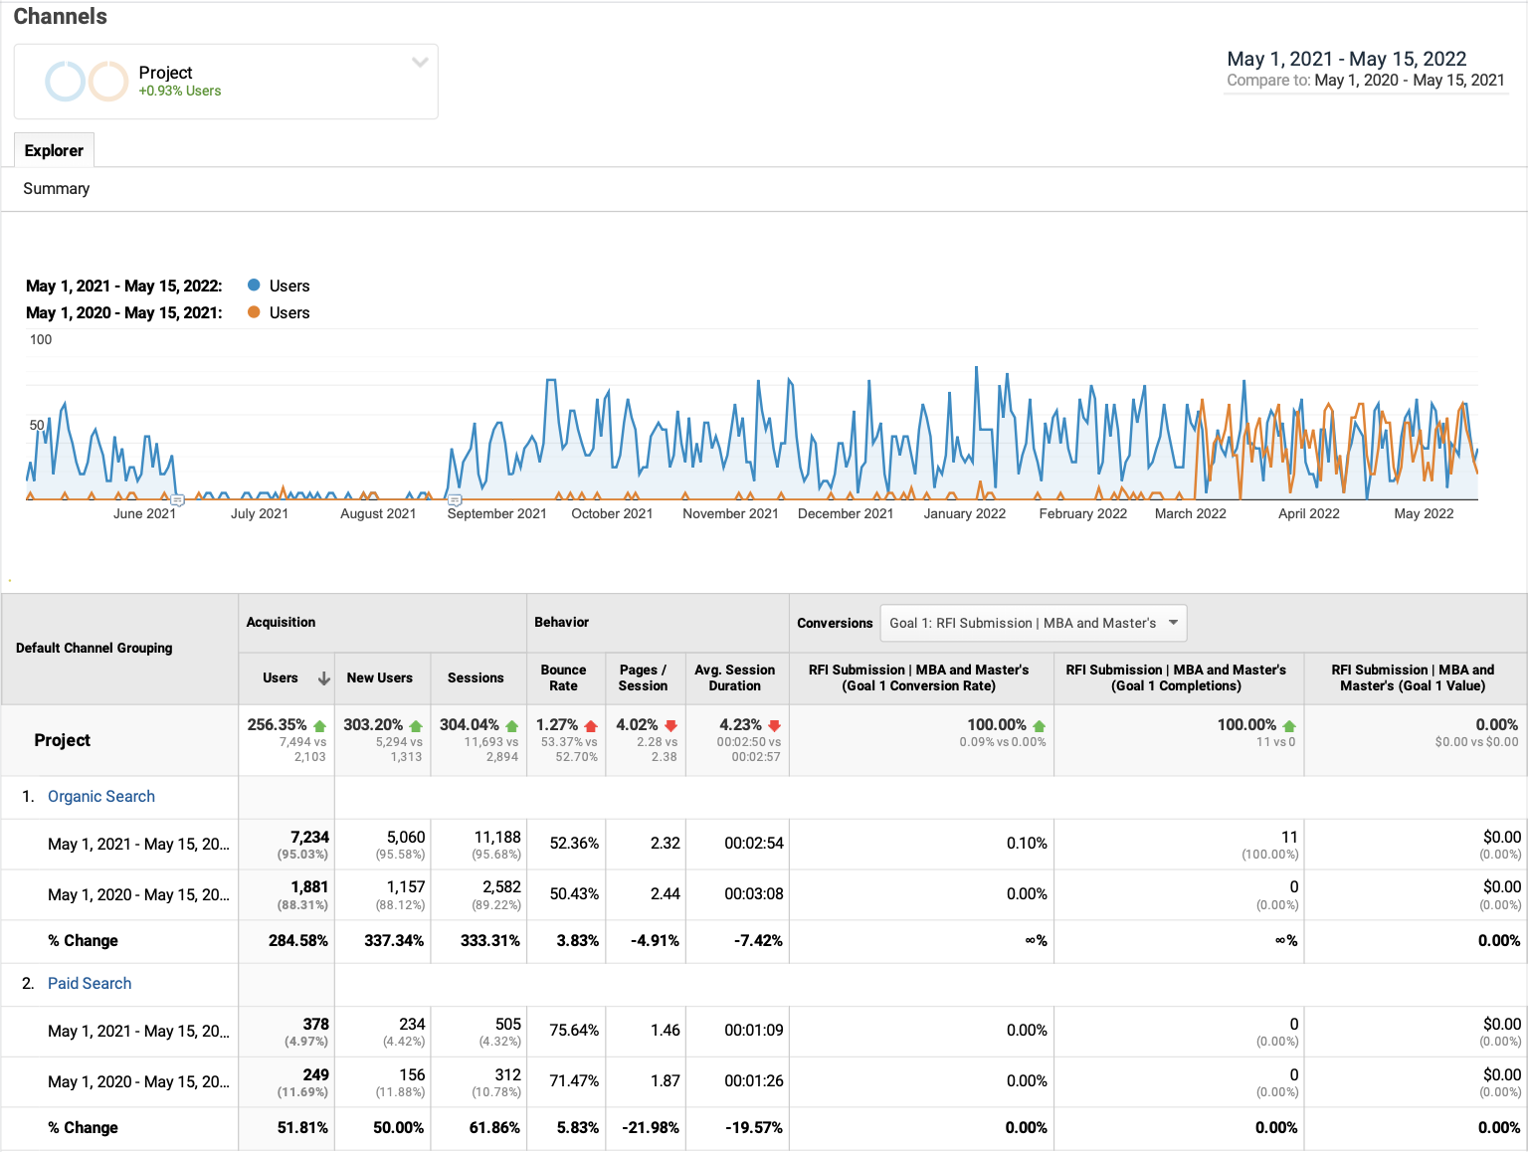
Both organic search & paid search are up

Slide 12
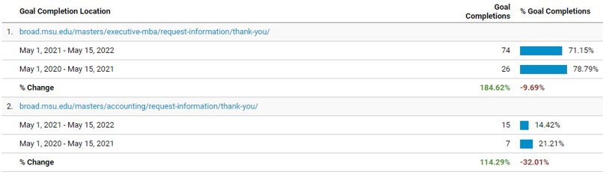
Goal Conversion Rate

Slide 13
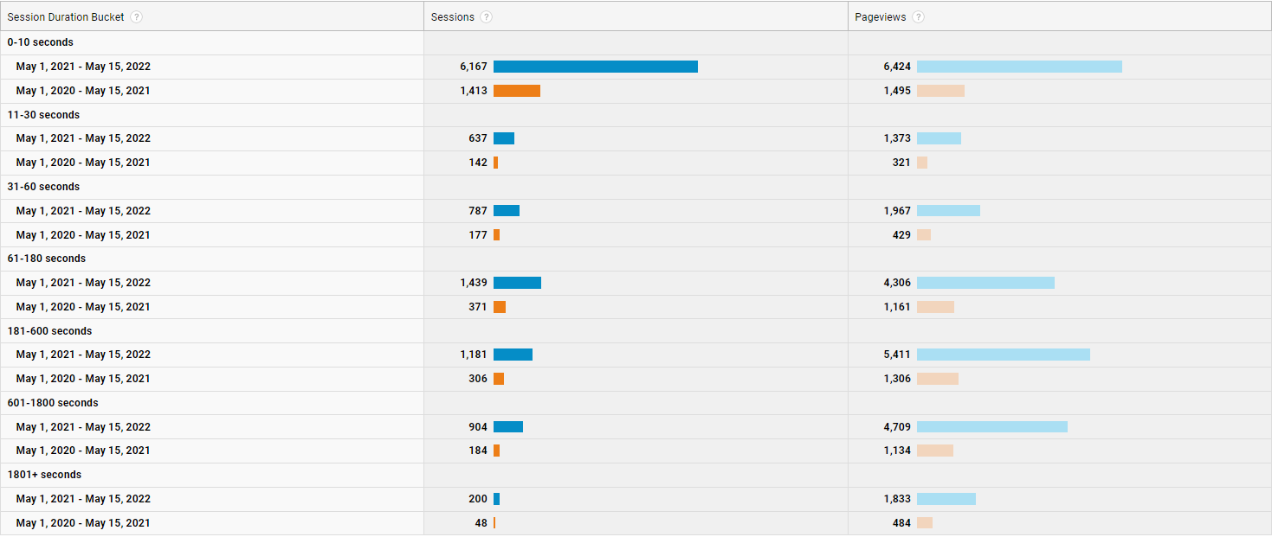

Slide 14
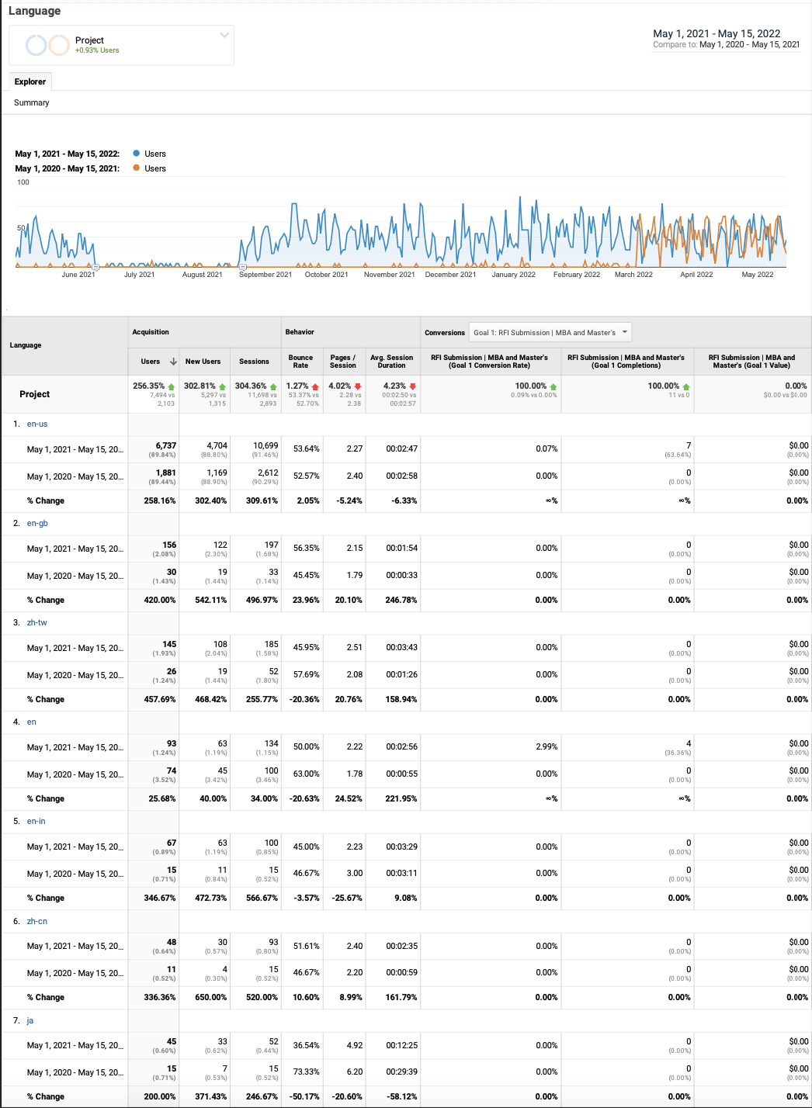

Slide 15
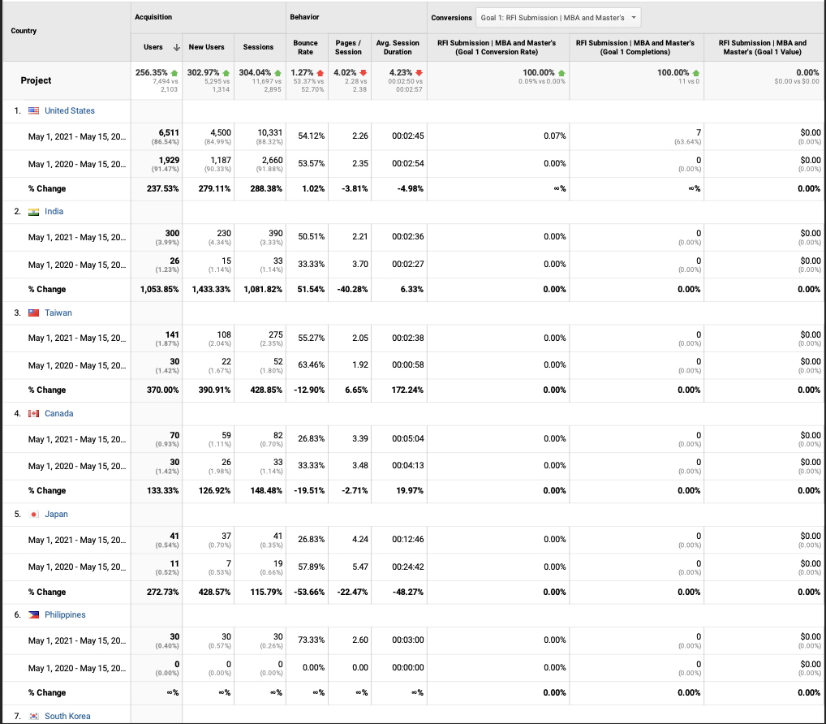

Slide 16
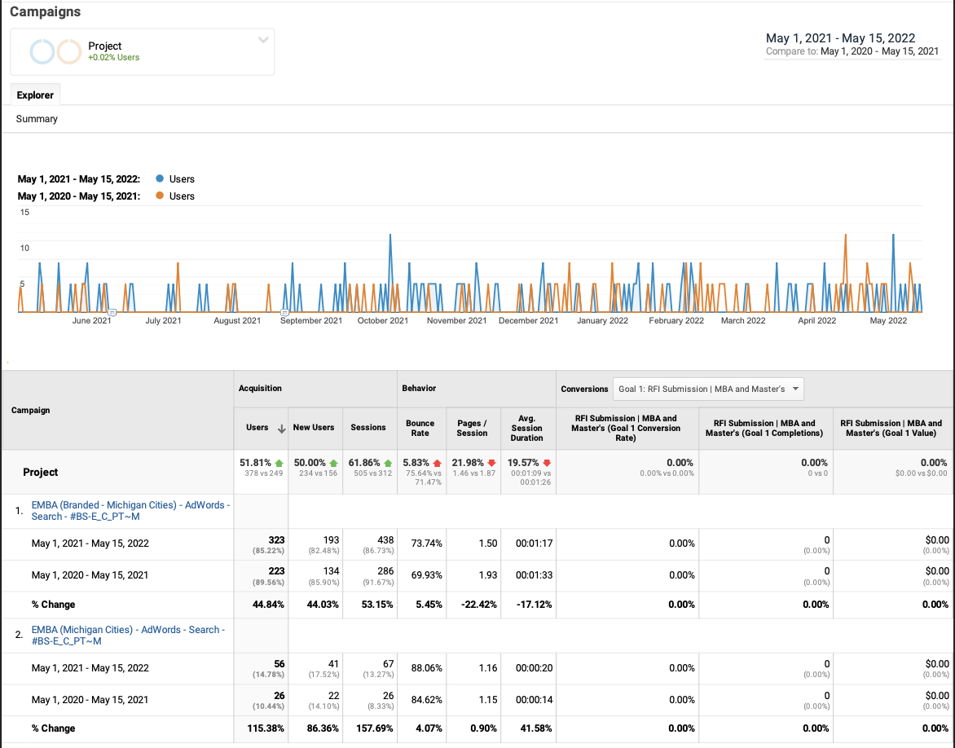

Slide 17
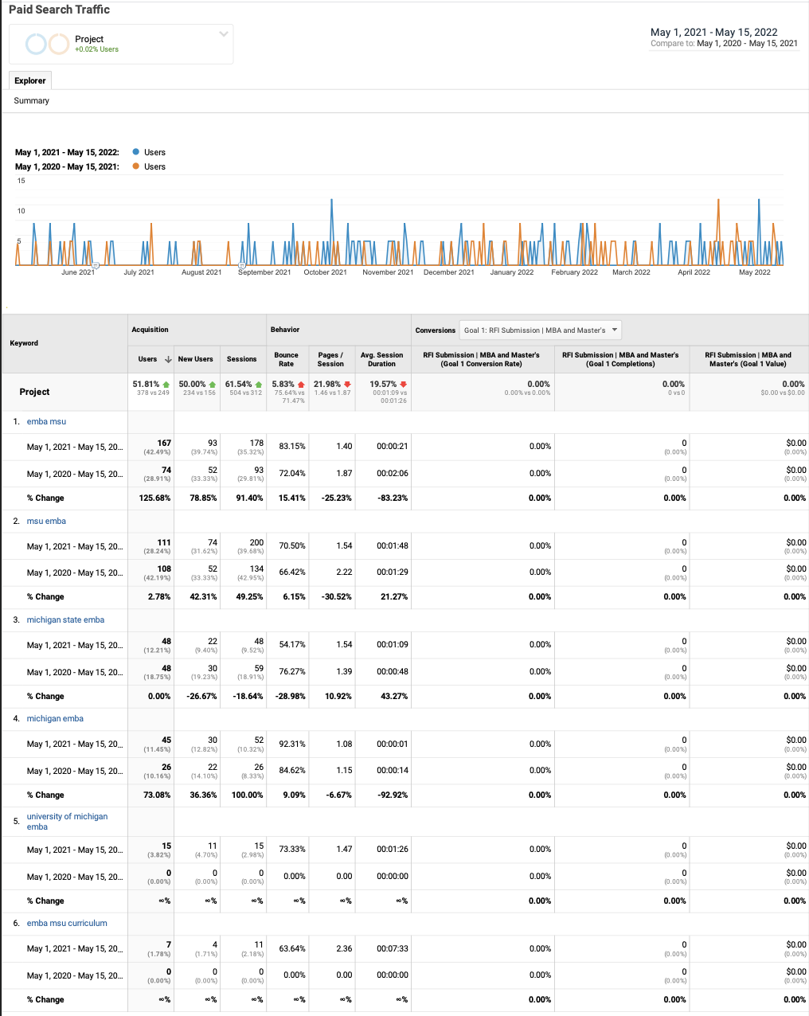
Paid Traffic Search

